Slide 1

How to measure IMPACT
Insights from an evaluator and professor
in theological education
Paul Penley, PhD
Director of Research
Excellence in Giving
Notes:
ASK: How many of you work for or support an organization that is measuring outcomes?
My entire life's work is the essence of this ICETE consultation, combining theological education with rigorous impact assessments.

Slide 2

Why measure outcomes
External Communication
Notes:
ASK: First REASON that comes to our mind is: for the donors
Is it just to get money OR to bless your supporters?
Luke's Gospel was written for a donor!

Slide 3

“I always wanted to know the measurable difference made from our significant investment of time and money in the Global Leadership Summit. Like many ministries, we had stories of impact but no concrete figures. Excellence in Giving's research changed all that. The data has now sharpened our strategies and given us confidence to approach donors we didn’t have before. I’ve been sharing the results with every financial and ministry partner we have around the world since we received the first Impact Report!”
- Gary Schwammlein, WCA President
Notes:
Research & Evaluation can build confidence with supporters: Willow Creek President can attest...
Impact Reporting encourages staff!

Slide 4
Why measure outcomes
Internal Improvement
Notes:
Second, and MOST IMPORTANT REASON to measure is: program improvement
You improve what you measure.
Forced to have tough conversations about your real priorities.
Do you think you're Perfect? No, then how are you learning? Because you are making decisions regardless

Slide 5

DOES THE ALLIANCE ACCELERATE IMPACT?
Notes:
350 evangelism ministries learning together
ASSUMPTION: every ministry gets better in the Alliance
GOAL: double the size to 700 evangelists in the Alliance
DATA: no statistical improvement from year 1 to year 10 in ministry impact.

Slide 6
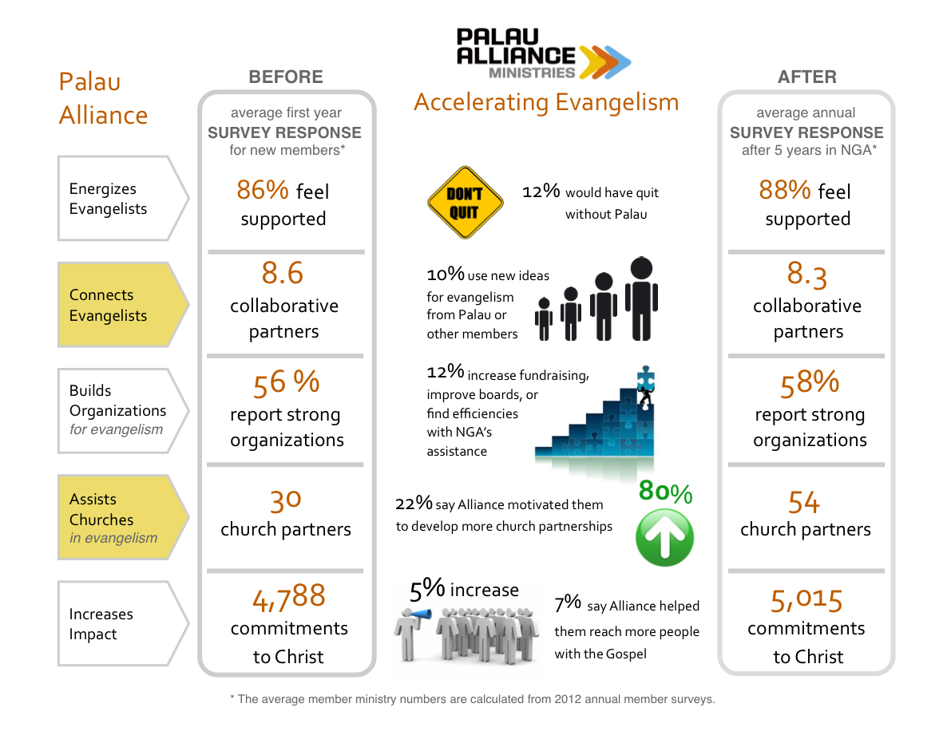
Notes:
No statistical improvement after 5 years other than church partners: YIKES!
These data were a tough reality check to show to the president. He wanted to know WHY?

Slide 7
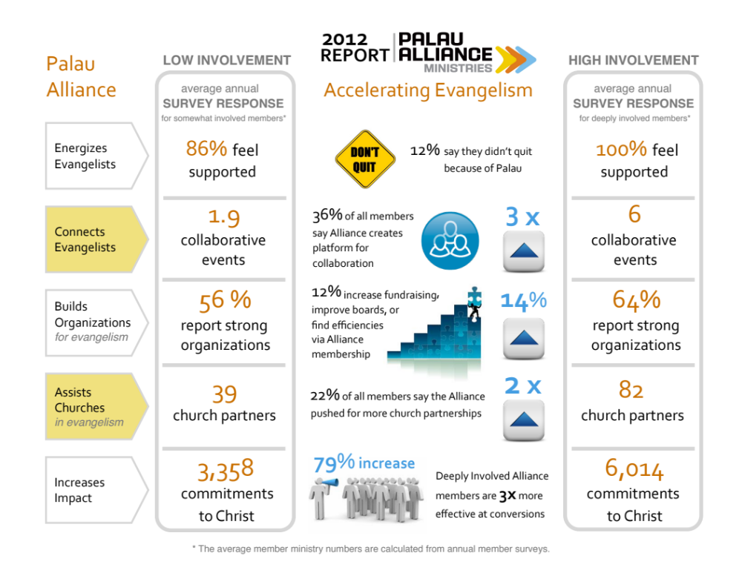
Notes:
Kept analyzing Impact Variables
SUCCESS FACTOR: Depth of participation NOT size of ministry, length of time, age, or location, etc. determined IMPACT
DATA-BACKED DECISION-MAKING: I recommended 6 concrete changes to policies and staff duties to Drive depth of participation not size of membership

Slide 8
Why measure outcomes
#1 Internal Improvement
#2 External Communication
Notes:
Internal Improvement is #1 reason
ASK: What reasons motivate you to measure outcomes?
Principle: Humble leaders committed to wise stewardship measure outcomes

Slide 9
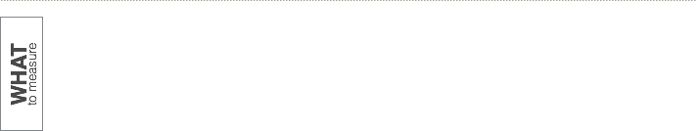
How to Measure Impact
Notes:
Data-backed decisions REPLACE decisions by "gut & guess"
BUDGET decisions based on what works. Invest in the Success Factors!

Slide 10

What to measure
How do you know when your mission is accomplished?
Notes:
Don't measure everything. Measure mission accomplishment.
"Effectiveness does not correspond to a Platonic ideal but rather to your stated purpose."
"When you see how well you are accomplishing it, you can assess if your mission is misguided."
How do you go from your MISSION to relevant METRICS?

Slide 11
DEFINE The mission
DEFINE goals
  Specific
  Attainable
  Measurable
DEFINITIONS
Notes:
Most have mission statements; not comment on the clarity and quality
Ministries use grandiose terms like "lift up leaders" or "send waves of peace across the land" or "to reach every child 4 Christ"
Define Goals:
BAD = to plant churches
SAMPLE GOAL #1: 75% of our graduates will start new churches or ministries in places with less than 2% Christian population.
SAMPLE GOAL #2: 50% of our PhD graduates will write the first contemporary Bible, theology, ethics, or missions book in their native language.
Principle: You have well-defined GOALS when you know if you have or have NOT achieved them.

Slide 12
DEFINE Key terms
  Leaders trained
How?
  Clarify the problem
  Define success
DEFINITIONS
Notes:
GOALS must be precise
Define verbs and key phrases
“leaders trained” – LENGTH, TYPE of People trained, ASSESSMENT of success
EXAMPLE: Graduates plant 2 house churches after 9 months of residential training in 13 subjects
ASK: What would it look like if you solved part of the problem? Different behavior, attitudes, knowledge? Affect individuals, schools, mental health, families?
PROBLEM: Untrained pastors and teachers distort the Word of God through bad hermeneutics.
SUCCESS: Bible teachers create teaching outlines based on the structure of the text and relate the biblical author's meaning to the contemporary context through illustration and application.

Slide 13

Notes:
TRANSFORMATION Graphics with 3-5 OUTCOMES are the sign you have defined the problem and your solution clearly.
Every MINISTRY should have one!
Measuring Outcomes measures transformational movement from left to right

Slide 14
What to measure
INPUTS
ACTIVITIES
OUTPUTS
OUTCOMES
Notes:
INPUTS = Number of staff, $1 million budget, 10-acre campus
ACTIVITIES = Teach 23 courses per semester, Run12 annual weekend seminars, publish quarterly journal
OUTPUTS = Graduated 76 students, 212 church leaders completed weekend seminars, distributed 2,300 journal volumes to 7 countries
ACTIVITIES & OUTPUTS = You are busy working on the problem, BUT…
OUTCOMES are indicators that you have SOLVED the PROBLEM to some degree
EXAMPLE = GOAL is trained people starting churches and parachurch leadership positions not JUST GETTING PEOPLE TRAINED

Slide 15
What to measure
We had 220 Graduates
VS.
68% of Graduates started a church, school, or ministry within 5 years
Notes:
OUTPUTS = # of warm meals, kids education sponsored, vaccines
OUTCOMES = Young adults who pay for their own medical care and meals with income from a job they got with their education

Slide 16

Notes:
Describe Historical Survey of Scholars and their impact on average 8 years after PhD graduation
Langham didn't cause but contributed to this accelerated impact
TRANSFORMATION GOALS
Unified = unite churches
Resourced = first books

Slide 17
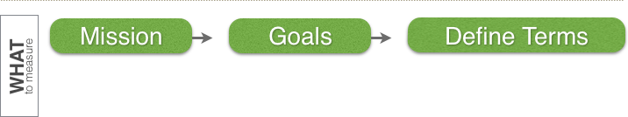
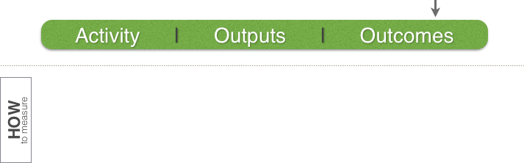
How to Measure Impact
Notes:
Defining Terms reveals concrete outcomes to measure
Now you know WHAT to measure, we can explore HOW...

Slide 18
What to measure
Practical EXERCISE:
Write down your organization’s mission statement and 1 goal.
Find a word (usually verbs) or phrase that needs to be defined more clearly.
Identify 1 long-term outcome you could measure and which activities and outputs are related to it.
Notes:
On your own, work from your mission to specific outcomes to measure.
We will continue building on what you have done in 2 more exercises later in this session

Slide 19
HOW to measure
“Measuring outcomes is important, but our ministry can’t do it.”
- every ministry leader
“Our mission is so important we can't afford to lead blindly.”
- humble ministry leader
Notes:
EXCUSE #1: We develop character and spiritual maturity; you can't measure that.
RESPONSE #1: Are you telling me I can't see any concrete signs of godly character and spiritual maturity?
Principle: The only ministry you can't measure is one with no goals.
But for the rest of us, it is not a question IF we can measure but HOW?
Mission is too important not to know how well we are accomplishing it and where to improve!!!

Slide 20
How to measure
Where do we get the data?
ACTIVITIES & OUTPUTS
    Organizational Data
OUTCOMES
    Beneficiary Surveys
Notes:
Ministries report ACTIVITIES & OUTPUTS because they have that organizational data on hand
"If you don't ask for OUTCOMES info, it's because you believe you can operate without it!" And you can, just not as effectively
SURVEYS are affordable; Biggest investment should be one-time investment into the DESIGN
Measuring OUTCOMES goes beyond what happens at your organization’s location or campus. So you have to reach out to people there after their participation in your program.

Slide 21
How to measure
Where do we start?
Too many outcomes to measure. How do you decide which ones to include in the survey?
Notes:
ASK: Which OUTCOMES are central to your mission?
With MULTIPLE programs and goals, you must select the CORE and CONSISTENT OUTCOMES. How do you choose your CORE outcomes?

Slide 22
How to measure
Gather & Categorize:
#1 Intended OUTCOMES
#2 Observed OUTCOMES
Notes:
To figure out CORE OUTCOMES to measure:
Look at “what goes in” (Intended OUTCOMES) and “what comes out” (Observed OUTCOMES)
You chose what you do on purpose (Intended OUTCOMES), but some outcomes are unanticipated byproducts of your values or execution (Observed OUTCOMES)

Slide 23
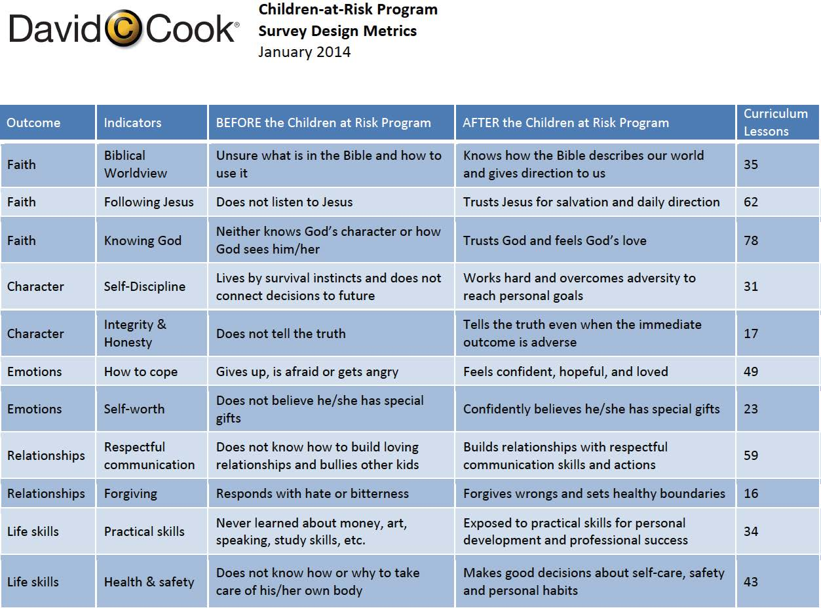
INTENDED OUTCOMES
Notes:
Move from individual activities to a summary of expected transformations: EXAMPLE – 21 lessons on same topic
400+ lessons are categorized in 5 key outcomes in spreadsheet
ASK about DOSAGE: Does our program or curriculum have a critical mass of activities to produce an outcome? If so, measure it.

Slide 24
How to measure
Where to find Observed OUTCOMES to gather and categorize:
Impact stories
Structured interviews
Focus groups
Notes:
IMPACT STORIES: Categorized themes in 1100 Impact stories from Global Leadership Summit
INTERVIEWS: ask 10% of your program beneficiaries the same set of questions
FOCUS GROUPS: can use open-ended question Online survey

Slide 25

Notes:
24 days – 15 flights – 9 cities – 5 countries – 3 continents – 76 interviews
QUALITATIVE RESEARCH

Slide 26
How to MEASURE
(Qualitative Research)
FIND Outcome THEMES
CREATE Closed-Ended QUESTIONS
(Quantitative Research)
Notes:
Transform Open-ended questions into a closed-set of answers = how to quantify type of impact
Multiple Choice options are derived from concrete actions and examples found repeatedly in the Qualitative Research (or Observed OUTCOME data)

Slide 27
How to MEASURE
Quantitative DATA answers key question about stories of impact:
Is this story the exception or the rule for program impact?
Notes:
Some stories exemplify the program’s impact for most beneficiaries; other stories mislead
SAD FACT: most ministries don’t know if stories are the norm or an anomaly.

Slide 28

How to MEASURE
After being rescued from a brothel in Thailand, Nani is the first girl to graduate high school from her family.
89%
of girls in aftercare graduate high school without returning to the sex trade
Notes:
No names without numbers, no numbers without names
STORIES x STATISTICS = STRATEGIC REPORTING
STATS tell us how REPRESENTATIVE the story is of all graduates

Slide 29
How to MEASURE
Track Impact VARIABLES:
    Location
    Experience
    Age
    Depth of Participation
Notes:
Impact VARIABLES are the key to actionable OUTCOMES data: Why it works or doesn't work
Mentoring EXAMPLE: Spiritual impact DOUBLES over Time from 1.5 years to 3 years in relationship
No Generic List of Variables– must be customized to your mission and activities and clients
Langham PREACHING Example – frequency in Preaching Clubs after Seminars

Slide 30
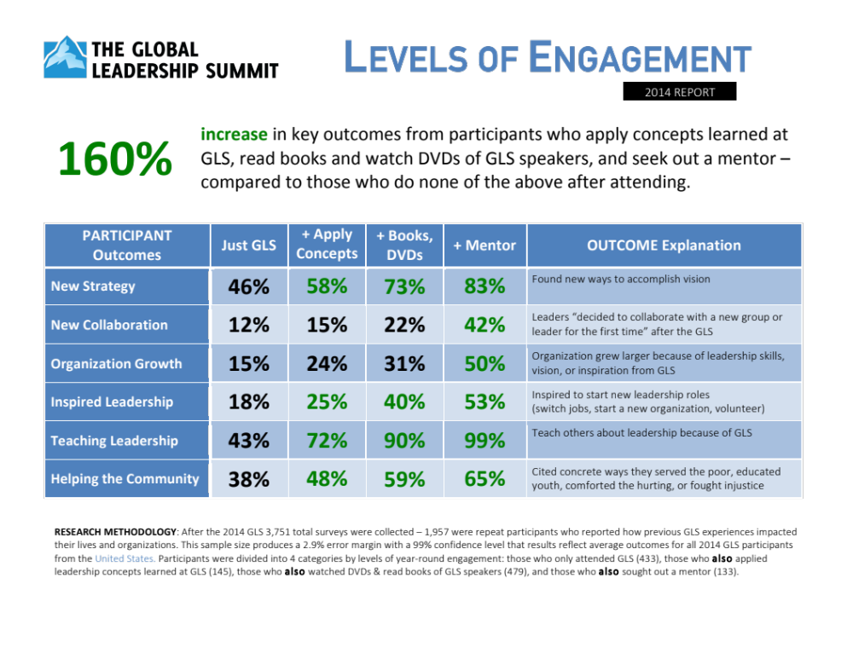
Notes:
IMPACT Variable: engagement in Leadership Development activities beyond the Summit drives IMPACT
Essential Ingredients in RECIPE for SUCCESS

Slide 31
How to create surveys
5 Steps to Survey RELIABILITY:
    Ask it 3 different ways
    Require specific details
    Avoid leading questions
    Use validated instruments
    Get 360 degree feedback
Notes:
3 different ways: Let respondents contradict themselves unknowingly
Specific Details: Don’t settle for general feedback of “it was a great experience”
Non-leading Questions: Positive answer options that attribute no credit to you
Validated instrument: Strength of Religious Faith Questionnaire validated thousands of times since 1990s
360 degree feedback: self-reported + your staff + their students + their family + their organization

Slide 32
How to create surveys
Survey USEFULNESS:
    Test it with small group
    Create templates for how you will report the data
Notes:
Test: Find unclear or meaningless questions and remove them to avoid SURVEY FATIGUE
Create Report Templates: Actionable intelligence not "interesting" trivia: "if you can't interpret the data so that it informs actions, don't collect it."

Slide 33
How to create surveys
IMPACT REPORT
        Acceleration
        Lasting Outcomes
IMPROVEMENT REPORT
        Negative trends
        Success Factors
Notes:
IMPACT Reports: what you have contributed to making happen long after your service.
ACCELERATION – we joined what God was doing and contributed; not creation ex nihilo
COUNTERFACTUALS: Most ministries don't have theology that permits the idea "we alone produced the results" so there is no goal to demonstrate "without us God would be powerless"; attitude is "God could have used someone else but we had the privilege"
IMPROVEMENT Reports: how to get better
"Improvement reports must contain simple and clear recommendations backed by facts."
FACT: 74% of kids who read with mentors start reading independently, but only 52% of mentors read books with students they're mentoring. RECOMMENDATION: So give mentors a recommended reading list by grade and train them how and when to read with kids.

Slide 34

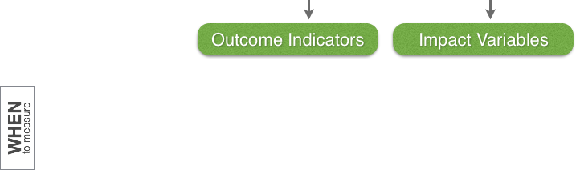
How to Measure Impact
Notes:
Ideal tool for tracking OUTCOMES is survey with concrete, closed set of answers for each question related to CORE outcomes you categorized from Intended and Observed OUTCOMES
Impact Variables = Why it works and how to improve

Slide 35
HOW to measure
Practical EXERCISE:
OUTCOME: Write down 3 common actions your graduates do because of their training.
OUTCOME INDICATORS: For 1 action, write down 3-5 ways graduates do those common actions differently in their context.
SURVEY QUESTION: Use the different ways graduates do one of the common actions to create 1 multiple-choice survey question.
Notes:
Example ACTIONS: Take leadership positions, start new organizations, train others
Different ways of doing COMMON ACTIONS: types of leadership positions, types of organizations started, different types of ministries
3) Create Multiple Choice question

Slide 36
When to measure
Which is better? 1-time longitudinal studies OR ongoing feedback loops?
When does transformation happen?
Notes:
One-time studies:
1) get out-dated and irrelevant fast
2) assume static system!!!
Ongoing feedback loops let you test effectiveness of program changes
Organizations are living organisms
WHEN: At what intervals do you expect transformation?

Slide 37

Transformation
BEFORE
AFTER
Notes:
Everyone claims TRANSFORMATION. But what does Transformation look like?
Nonprofits need to measure the BEFORE picture (baselines & benchmarks) and the AFTER picture (clear improvement from the baseline or benchmark)
If you don’t have a one-page graphic of what your beneficiaries are like before your service and where they are after, add it to your “to do” list

Slide 38
When to measure
3 typical times to MEASURE:
BEFORE program participation
END of program participation
1-5 Years AFTER program completion
Notes:
Historical Surveys can do all 3 – ask Alumni to reflect on pre- and post-program activity, attitudes, knowledge, and influence

Slide 39
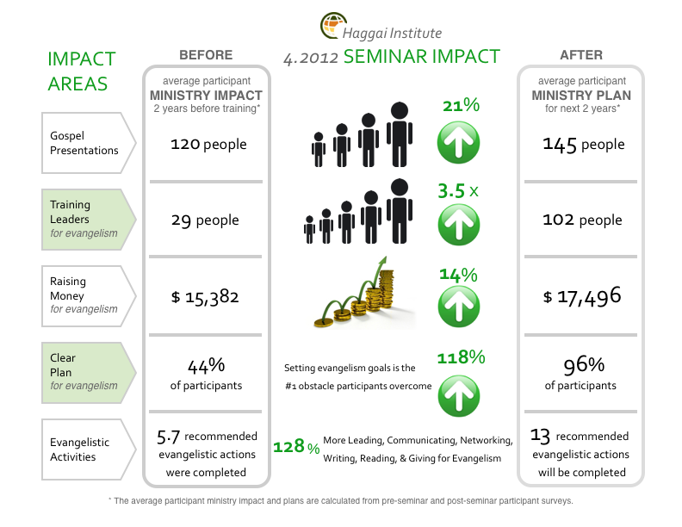
Notes:
HAGGAI INSTITUTE can have participants take survey on first day of training
COMPARE plans on last day of training and then follow up at 1 & 2 years later
ILL: Haggai Institute states goal is students TRAIN 100 OTHERS; measured # of people planned to teach was less than 100; that LEARNING led to CHANGE which must be MEASURED

Slide 40
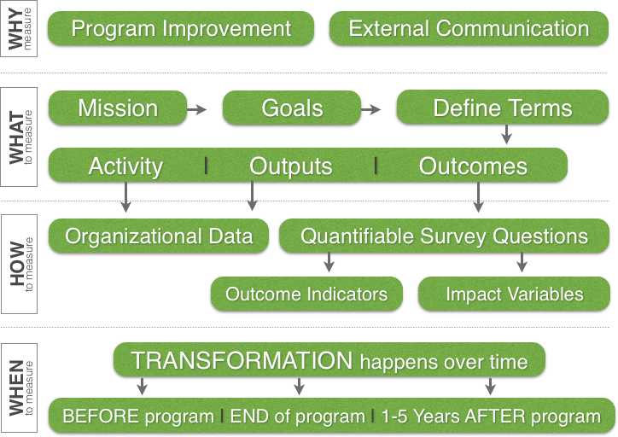
How to Measure Impact
Notes:
Growth takes time. God is not in hurry.
Bible uses biological growth analogy

Slide 41
WHEN to measure
Practical EXERCISE:
MEASUREMENT INTERVALS: Pick up to 3 times when you could survey your beneficiaries.
SURVEY INTEGRATION: Identify current paperwork in which you could integrate surveys.
Notes:
Process must be EFFICIENT and gathering outcomes data must be equally important to your other paperwork
EXERCISE: Write answers on same sheet of paper or electronic device

Slide 42
How to measure IMPACT
Insights from a professor and evaluator
in theological education
Paul Penley, PhD
Director of Research
Excellence in Giving
Notes:
Contact me with questions at ExcellenceinGiving.com

Slide 43
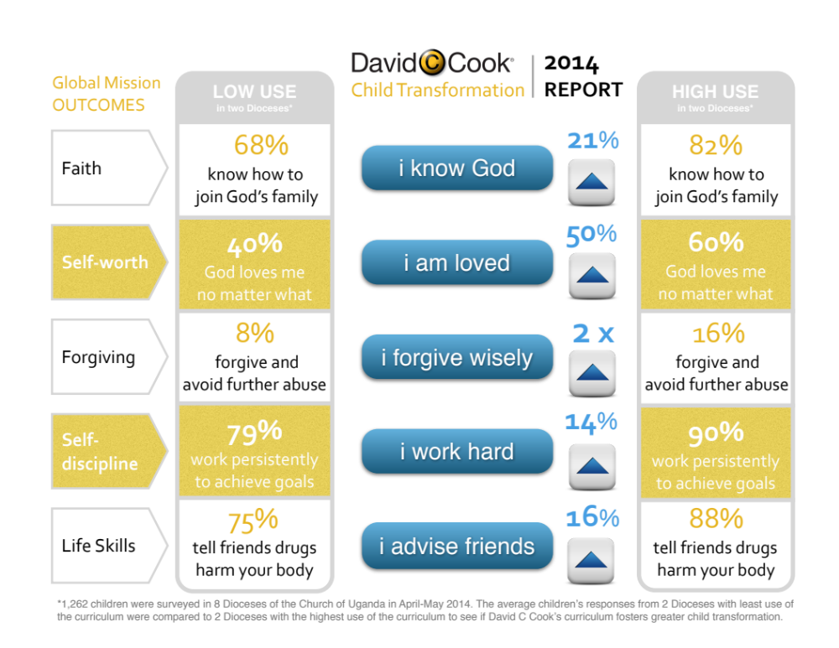
Notes:
Each OUTCOME has multiple INDICATORS but no report should report more than 5
Each Department should have their 3-5 KEY OUTCOMES that inform INTERNAL IMPROVEMENTS

